Slide 1


<Jean Shepherd>
<18 Dec, 2024>

Slide 2

Outline
Executive Summary
Introduction
Methodology
Results
Conclusion
Appendix

Slide 3
Executive Summary
Summary of methodologies
Summary of all results

Slide 4
Introduction
Project background and context
SpaceX advertises Falcon 9 rocket launches on its website with a cost of 62 million dollars; other providers cost upward of 165 million dollars each, much of the savings is because SpaceX can reuse the first stage. Therefore if we can determine if the first stage will land, we can determine the cost of a launch. This information can be used if an alternate company wants to bid against SpaceX for a rocket launch
Problems you want to find answers
Predict if the first stage will lang

Slide 5

Section 1

Slide 6
Methodology
Executive Summary
Data collection methodology:
Use API call with api.spacexdata.com
Use Web Scraping with Python library beautifulsoup4
Perform data wrangling
Use pandas and numpy process data
Perform exploratory data analysis (EDA) using visualization and SQL
Perform interactive visual analytics using Folium and Plotly Dash
Perform predictive analysis using classification models
Use scikit-learn to build, tune, evaluate classification models

Slide 7
Data Collection
Describe how data sets were collected.
Method 1: web scraping
Method 2: SpaceX API call
You need to present your data collection process use key phrases and flowcharts

Slide 8
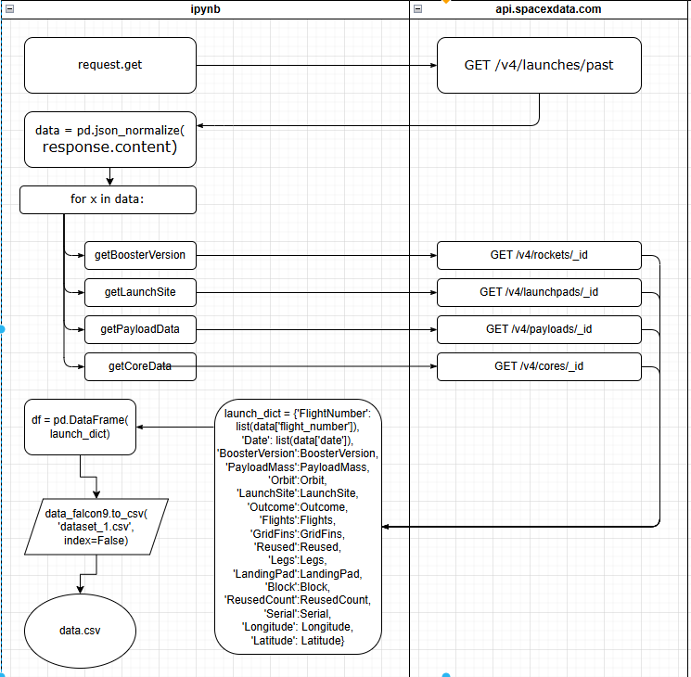
Data Collection – SpaceX API
Present your data collection with SpaceX REST calls using key phrases and flowcharts
https://github.com/JeanG00/data-analysis-space-x/blob/master/notebooks/apply_1_SpaceX_api.ipynb
Place your flowchart of SpaceX API calls here

Slide 9
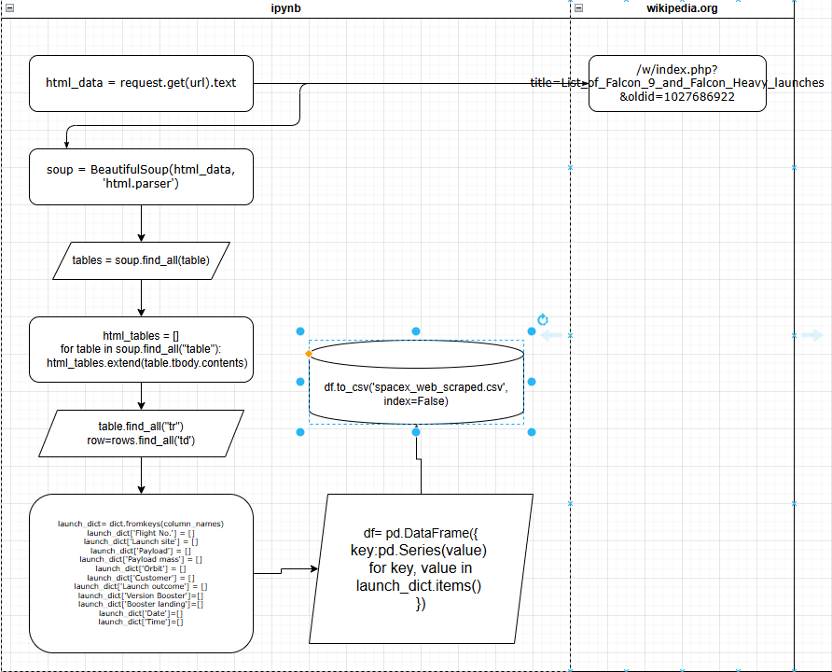
Data Collection - Scraping
Present your web scraping process using key phrases and flowcharts
https://github.com/JeanG00/data-analysis-space-x/blob/master/notebooks/apply_1B_SpaceX_scraping.ipynb
Place your flowchart of web scraping here

Slide 10
Data Wrangling
Describe how data were processed
String manipulation with data cells to remove unnecessary parts
Identify and calculate the percentage of the missing values in each attribute
Identify which columns are numerical and categorical
key phrases
df.isnull().sum()
len(df)
df.loc[]
df.iloc[]
https://github.com/JeanG00/data-analysis-space-x/blob/master/notebooks/apply_1C_SpaceX_data_wrangling.ipynb

Slide 11
EDA with Data Visualization
Summarize what charts were plotted and why you used those charts
Line plot - best suited for trend-based visualizations of data over a period of time
Scatter plot - a useful way of comparing variables against each other
Bar plot - a way of representing data where the length of the bars represents the magnitude/size of the feature/variable
https://github.com/JeanG00/data-analysis-space-x/blob/master/notebooks/apply_2B_EDA.ipynb

Slide 12
EDA with SQL
Using bullet point format, summarize the SQL queries you performed
DROP TABLE
CREATE TABLE
SLECT * FROM TABLE GROUP BY COLUMN
SELECT AVG("PAYLOAD_MASS__KG_") FROM SPACEXTBL WHERE "Booster_Version" LIKE "%F9 v1.1%"
SELECT COUNT(*) as "Mission", "Mission_Outcome" FROM SPACEXTBL GROUP BY "Mission_Outcome"
https://github.com/JeanG00/data-analysis-space-x/blob/master/notebooks/apply_2_SQL.ipynb

Slide 13
Build an Interactive Map with Folium
Summarize what map objects such as markers, circles, lines, etc. you created and added to a folium map
Folium.Circle - drawing circle overlays on a map
Folium.map.Marker - Create a simple marker on the map, with optional popup text
Folium.Icon - enrich user experience
Folium.Popup - making the web page more interactive
Folium.PolyLine - creates line object overlays on the map
https://github.com/JeanG00/data-analysis-space-x/blob/master/notebooks/apply_3_folium_launch_site_location.ipynb

Slide 14
Build a Dashboard with Plotly Dash
Summarize what plots/graphs and interactions you have added to a dashboard
Pie chart - A. to see which sites has the largest success count B. to check detailed success rate (class=0 vs. class=1) on one site
Scatter chart - visually observe how payload may be correlated with mission outcomes for selected site(s)
https://github.com/JeanG00/data-analysis-space-x/blob/master/notebooks/apply_3B_plotly_dash.py

Slide 15
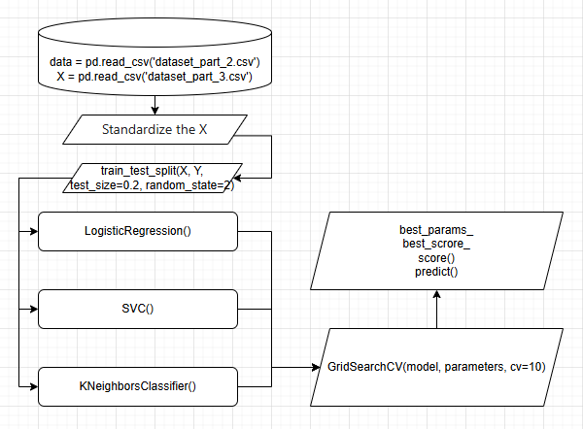
Predictive Analysis (Classification)
Summarize how you built, evaluated, improved, and found the best performing classification model
Load data
Standardize the data
Create train and test data sets
Create different models and calc the score
Use GridSearchCV find best model
https://github.com/JeanG00/data-analysis-space-x/blob/master/notebooks/apply_4_SpaceX_MLP.ipynb

Slide 16
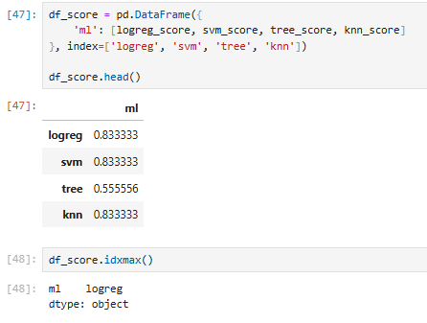
Results
Exploratory data analysis results
Models share similar scores
Interactive analytics demo in screenshots
As picture right displays
Predictive analysis results
Predictions share similar results

Slide 17

Section 2

Slide 18
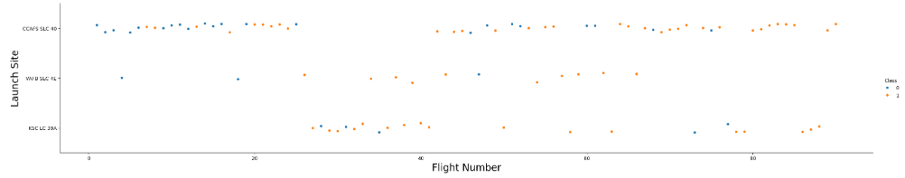
Flight Number vs. Launch Site
Show a scatter plot of Flight Number vs. Launch Site
Show the screenshot of the scatter plot with explanations
Most rockets was launched at CCAFS SLC 40
KSC LC 39A was put into use after 25 launches
VAFB SLC 4E does not rarely launch rockets

Slide 19
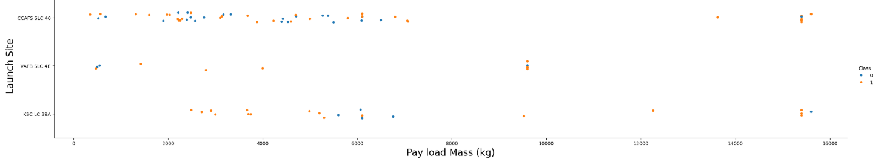
Payload vs. Launch Site
Show a scatter plot of Payload vs. Launch Site
Show the screenshot of the scatter plot with explanations
CCAFS SLC 40 and KSC LC 39A was used for heavy-weight rockets launch
VAFB SLC 4E was used for middle-weight rockets launch

Slide 20
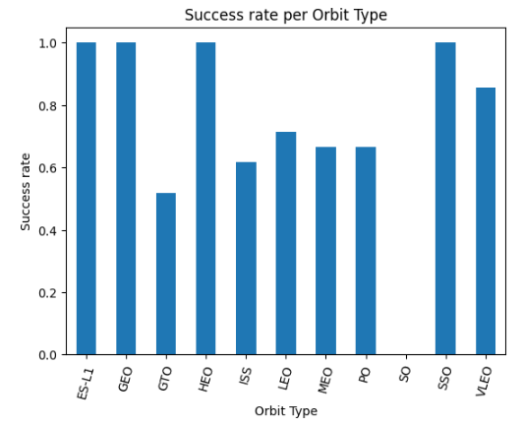
Success Rate vs. Orbit Type
Show a bar chart for the success rate of each orbit type
Show the screenshot of the scatter plot with explanations
Orbit type with GTO has lowest success rate
Orbit type with ISS, MEO, PO share similar success rate
Orbit type with ES-L1, GEO, HEO, SSO has remarkable success rate

Slide 21
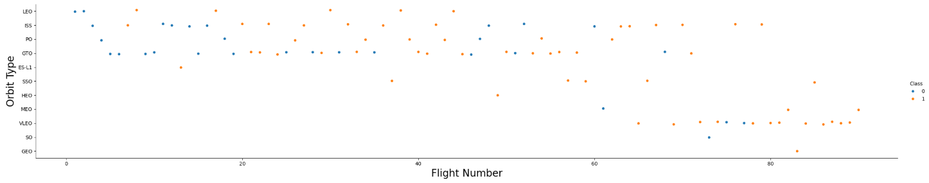
Flight Number vs. Orbit Type
Show a scatter point of Flight number vs. Orbit type
Show the screenshot of the scatter plot with explanations
Rockets were launched at lower orbit in the beginning, as success rate rises, they goes to higher orbit.
Orbit type with LEO, ISS, FO, GTO were frequently launched

Slide 22
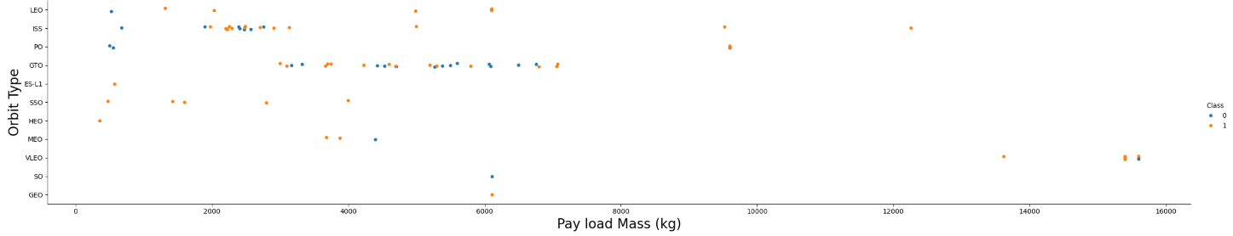
Payload vs. Orbit Type
Show a scatter point of payload vs. orbit type
Show the screenshot of the scatter plot with explanations
Rockets launch more light-weight payload than heavy-weight
Heavy-weight above 15,000 kg were only launched at VLEO for observation and test purpose

Slide 23
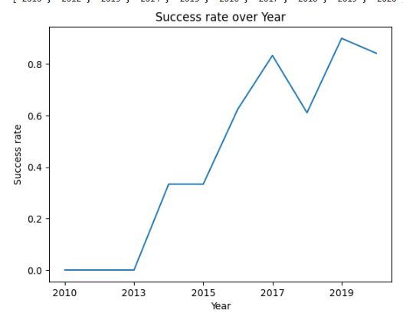
Launch Success Yearly Trend
Show a line chart of yearly average success rate
Show the screenshot of the scatter plot with explanations
The first success launch starts from 2013
The success rates goes up quickly as year goes by
The success rates drops between 2017 and 2018, maybe new technical test carried out?

Slide 24
All Launch Site Names
Find the names of the unique launch sites
SELECT DISTINCT Launch_Site FROM SPACEXTBL
Present your query result with a short explanation here
CCAFS LC-40
CCAFS SLC-40
KSC LC-39A
VAFB SLC-4E
There are 4 unique launch sites, CCAFS LC-40 and CCAFS SLC-40 are probably close to each other

Slide 25
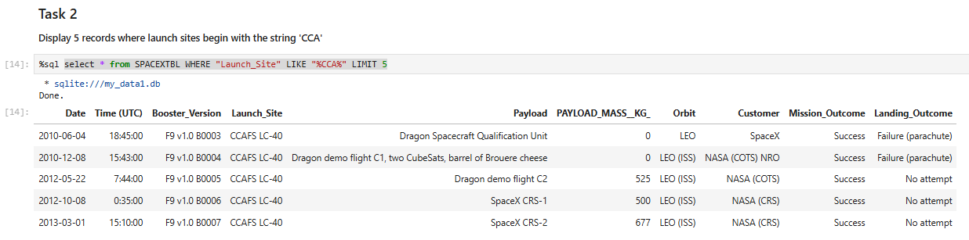
Launch Site Names Begin with 'CCA'
Find 5 records where launch sites begin with `CCA`
SELECT * FROM SPACEXTBL WHERE "Launch_Site" LIKE "%CCA%" LIMIT 5
Present your query result with a short explanation here
From the booster version number we can see CCA% sites are put into use quite early

Slide 26
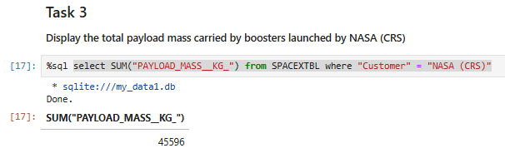
Total Payload Mass
Calculate the total payload carried by boosters from NASA
SELECT SUM("PAYLOAD_MASS__KG_") FROM SPACEXTBL WHER "Customer" = "NASA (CRS)"
Present your query result with a short explanation here
`WHERE` clause are used for filtering
`SUM` clause are used for math calculation

Slide 27
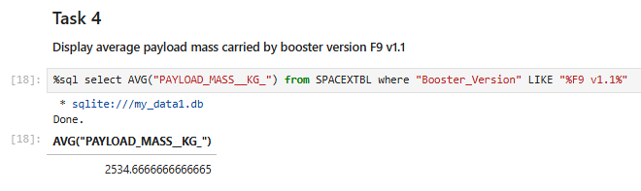
Average Payload Mass by F9 v1.1
Calculate the average payload mass carried by booster version F9 v1.1
SELECT AVG("PAYLOAD_MASS__KG_") FROM SPACEXTBL WHERE "Booster_Version" LIKE "%F9 v1.1%"
Present your query result with a short explanation here
The average payload mass in kilogram is 2535(kg)

Slide 28
First Successful Ground Landing Date
Find the dates of the first successful landing outcome on ground pad
SELECT MIN("Date") FROM SPACEXTBL WHERE "Landing_Outcome" = "Success (ground pad)" AND "Mission_Outcome" = "Success"
Present your query result with a short explanation here
By `MIN()` function we get 2015-12-22

Slide 29
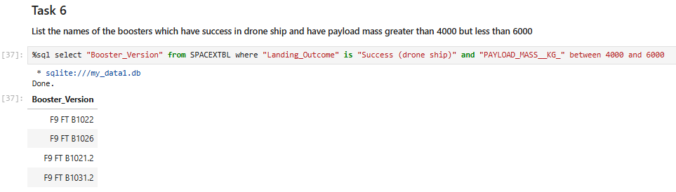
Successful Drone Ship Landing with Payload between 4000 and 6000
List the names of boosters which have successfully landed on drone ship and had payload mass greater than 4000 but less than 6000
select "Booster_Version" from SPACEXTBL where "Landing_Outcome" is "Success (drone ship)" and "PAYLOAD_MASS__KG_" between 4000 and 6000
Present your query result with a short explanation here
Falcon 9

Slide 30
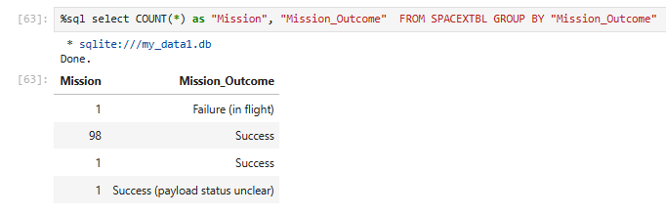
Total Number of Successful and Failure Mission Outcomes
Calculate the total number of successful and failure mission outcomes
select COUNT(*) as "Mission", "Mission_Outcome" FROM SPACEXTBL GROUP BY "Mission_Outcome"
Present your query result with a short explanation here
We can see that success rate are quite high

Slide 31
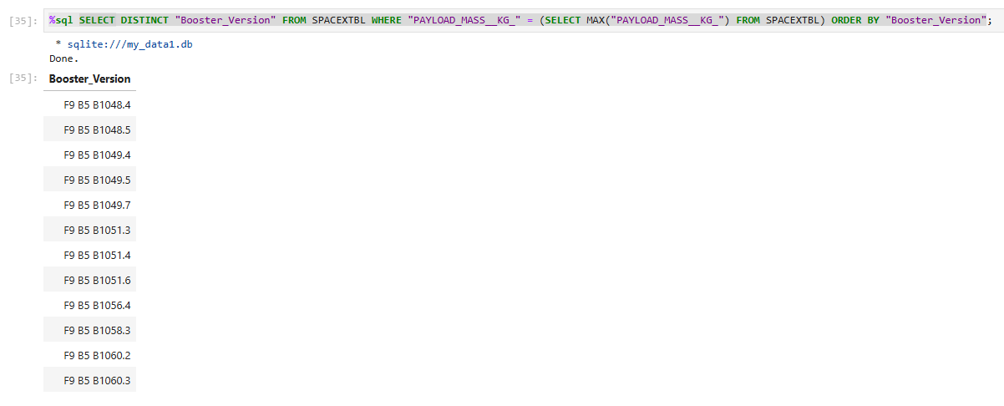
Boosters Carried Maximum Payload
List the names of the booster which have carried the maximum payload mass
SELECT DISTINCT "Booster_Version" FROM SPACEXTBL WHERE "PAYLOAD_MASS__KG_" = (SELECT MAX("PAYLOAD_MASS__KG_") FROM SPACEXTBL) ORDER BY "Booster_Version"
Present your query result with a short explanation here
Falcon 9 B5

Slide 32
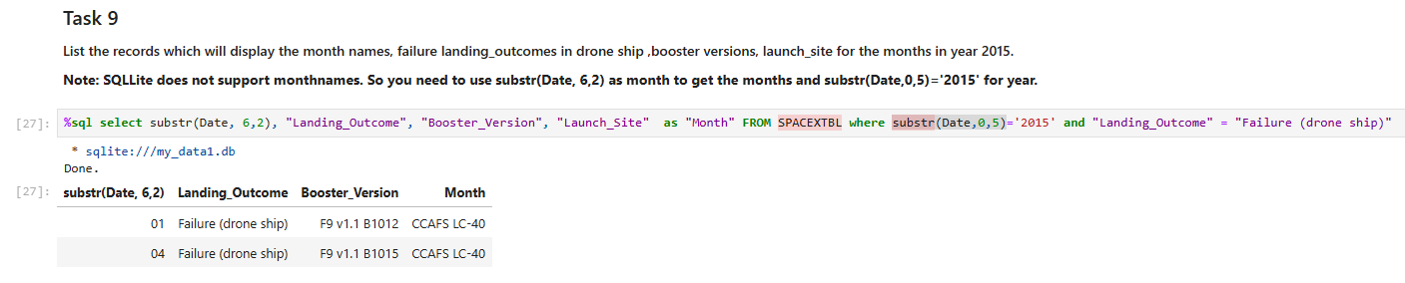
2015 Launch Records
List the failed landing_outcomes in drone ship, their booster versions, and launch site names for in year 2015
select substr(Date, 6,2), "Landing_Outcome", "Booster_Version", "Launch_Site" as "Month" FROM SPACEXTBL where substr(Date,0,5)='2015' and "Landing_Outcome" = "Failure (drone ship)"
Present your query result with a short explanation here

Slide 33
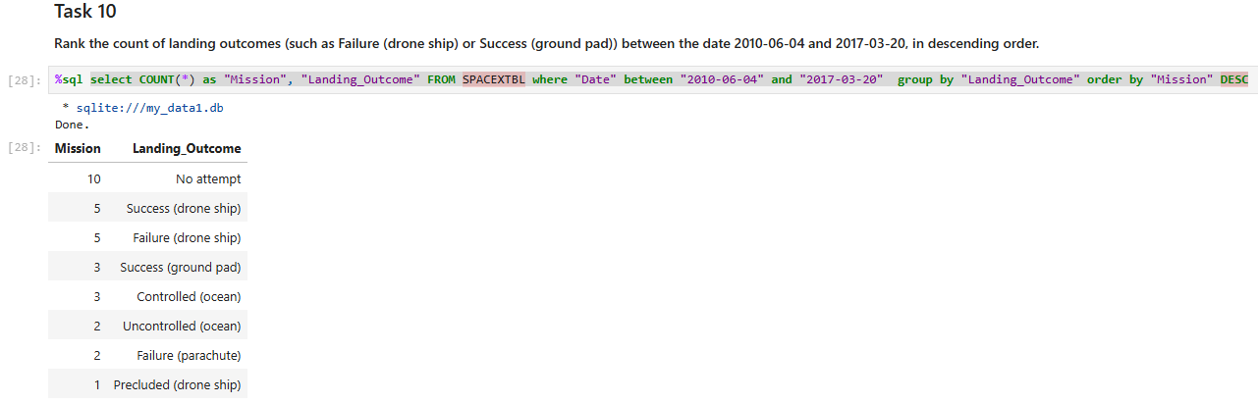
Rank Landing Outcomes Between 2010-06-04 and 2017-03-20
Rank the count of landing outcomes (such as Failure (drone ship) or Success (ground pad)) between the date 2010-06-04 and 2017-03-20, in descending order
select COUNT(*) as "Mission", "Landing_Outcome" FROM SPACEXTBL where "Date" between "2010-06-04" and "2017-03-20" group by "Landing_Outcome" order by "Mission" DESC
Present your query result with a short explanation here
Landing Outcomes with "No
attempt" is the first outcome

Slide 34

Section 3

Slide 35
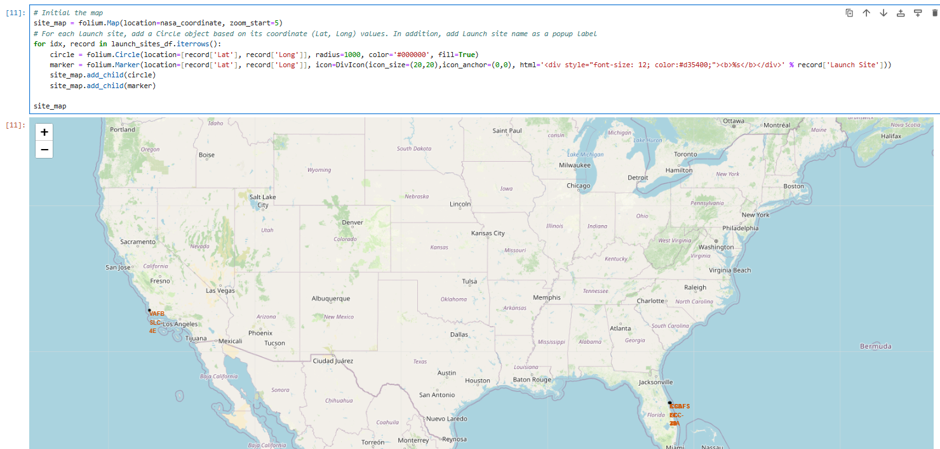
Launch site distribution
Explain the important elements and findings on the screenshot
There are two major launch sites, one near to Pacific Ocean and the other to Atlantic Ocean

Slide 36
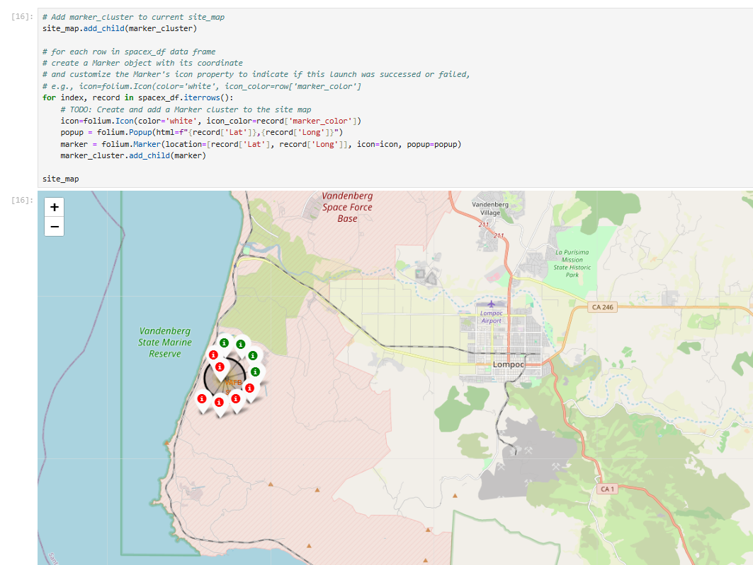
Success/failed launches for each site
Explain the important elements and findings on the screenshot
The coordinate data are quite close to each other

Slide 37
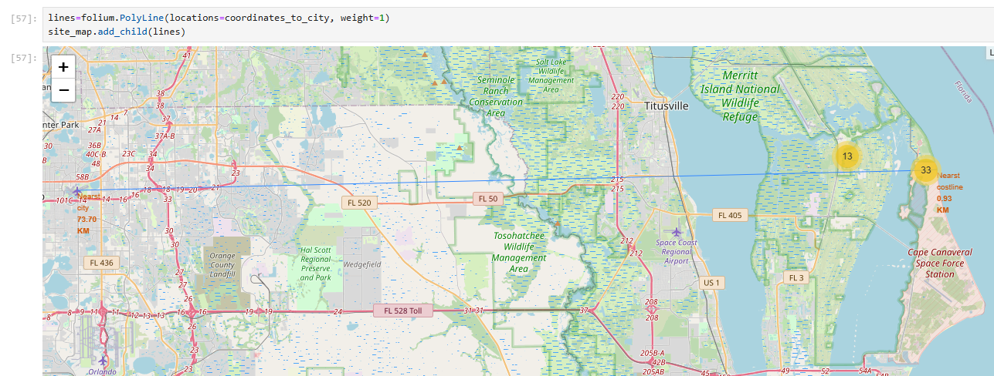
Calculate the distances between a launch site to its proximities
Explain the important elements and findings on the screenshot
CCAFS LC-40 to Nearest costline 0.93km
CCAFS LC-40 to Nearest city (Orlando Airport) 73.70km

Slide 38

Section 4

Slide 39
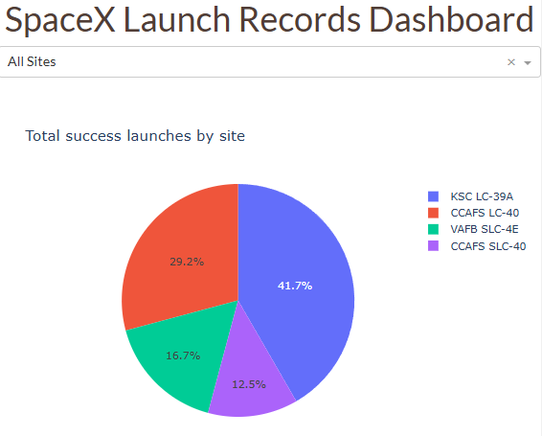
Total success launches by site
Explain the important elements and findings on the screenshot
KSC LC-39A has highest success rate of launches
CCAFS SLC-40 has lowest success rate of launches

Slide 40
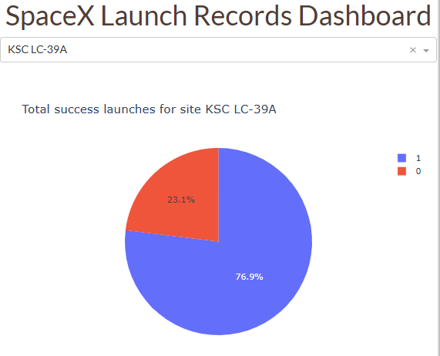
Site of highest launch success ratio
Explain the important elements and findings on the screenshot
The success rate is approximately 76.9%

Slide 41
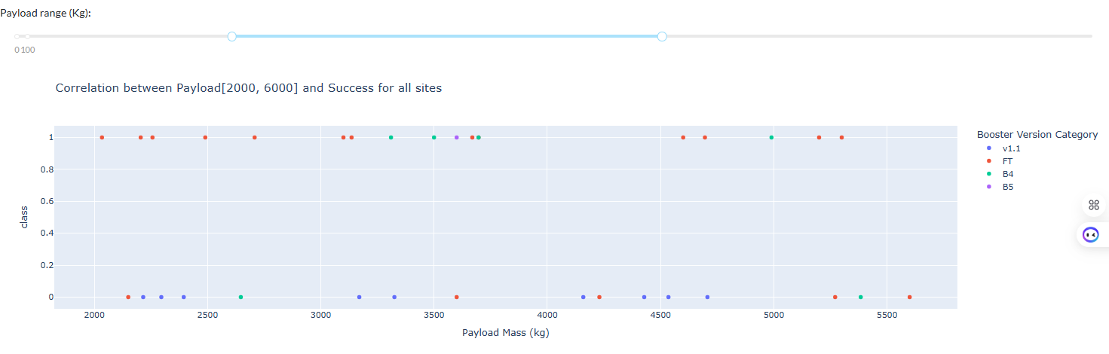
Payload vs. Launch Outcome slider
Explain the important elements and findings on the screenshot, such as which payload range or booster version have the largest success rate, etc.
Payload range between 5500kg and 9000kg has the largest success rate of 1

Slide 42

Section 5

Slide 43
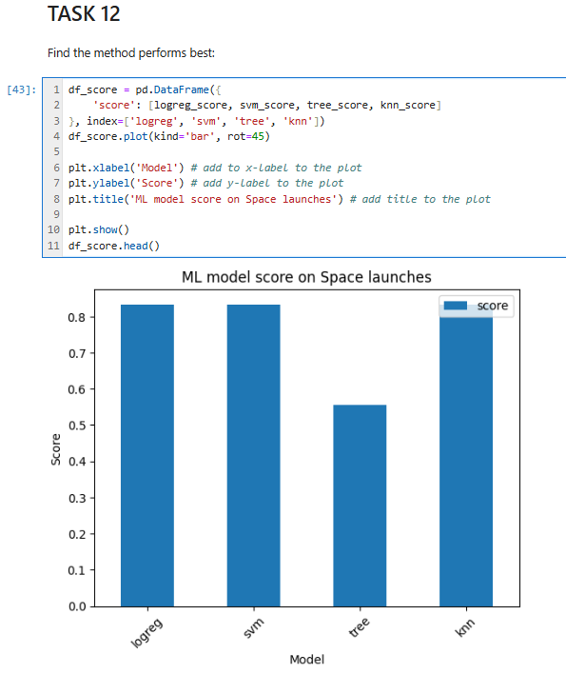
Classification Accuracy
Visualize the built model accuracy for all built classification models, in a bar chart
Find which model has the highest classification accuracy
Models share similar accuracy
Probable cause: dataset too small

Slide 44
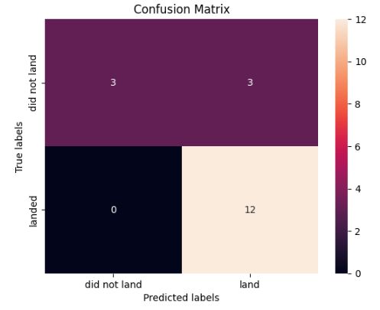
Confusion Matrix
Show the confusion matrix of the best performing model with an explanation
A true positive is an outcome where the model correctly predicts the positive class.
A false positive is an outcome where the model incorrectly predicts the positive class.

Slide 45
Conclusions
Dataset size affect predict accuracy significantly
Good classifier model parameters will accelerate the process finding best models
Good usage of appropriate chart type helps us understanding data easily
Data analysis is crucial in various fields such as business, science, research, and many others to make informed decisions and predictions based on data patterns and trends

Slide 46
Appendix
Include any relevant assets like Python code snippets, SQL queries, charts, Notebook outputs, or data sets that you may have created during this project
df_score.idxmax()
df = data._get_numeric_data()
popup = folium.Popup(html=f"{record['Lat']},{record['Long']}")
df['Landing_Outcome'].unique()
select MAX("PAYLOAD_MASS__KG_") FROM SPACEXTBL
select DISTINCT Launch_Site FROM SPACEXTBL
colunm_name.replace(r'.', '').replace(r'(', '').replace(r')', '').strip()

Slide 47


